Slide 1



ARCHITECTURE OF HIBERNATE
Chapter 2

Slide 2
Today’s Agenda
In Depth Understanding Of Hibernate
Architecture Of Hibernate
Layers In Hibernate
Files Needed For An Hibernate Application
Details Of These Files

Slide 3
Hibernate Architecture
Before writing hibernate based applications , it is extremely important for us to understand it’s architecture.
There are 4 layers in Hibernate architecture:
Java application layer
Hibernate framework layer
Backend api layer and
Database layer

Slide 4
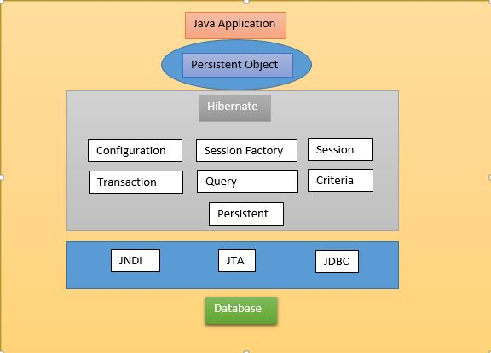
Hibernate Layers

Slide 5
Hibernate Architecture
First Layer: Java Application Layer
This layer consists of all the classes, variables and objects that define the business logic of the application. These classes communicate with hibernate.
Second Layer: Hibernate Layer
Then comes, the Hibernate and it’s core principles, using which we could persist ( store or save and retrieve ) the objects of our business layer classes by communicating with the database server layer.

Slide 6
Hibernate Architecture
Third Layer: Back End API Layer
Hibernate internally uses the Java core API and Java Database Connectivity(JDBC) to communicate with the database in order to persist the state of an object by performing create , read , update, delete(CRUD) operations.
Fourth Layer: Database Layer
This layer is where Hibernate actually uses JDBC drivers to interact with the database and performs CRUD operations

Slide 7
Files To Be Created For Hibernate
Every Hibernate based application contains at least 4 files which must be developed by the programmer to communicate with the database.
These 4 files are :
Mapping File
Configuration File
Persistent class
Java class to hold logic
These are XML files
These are Java files

Slide 8
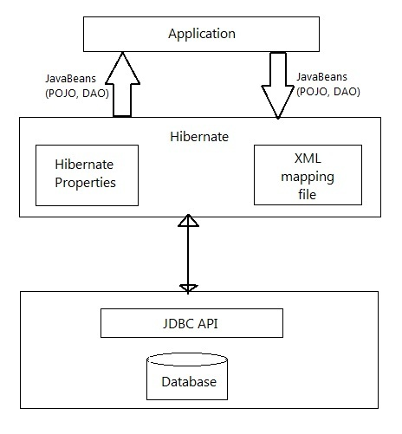
Files In An Hibernate App

Slide 9
What Is A Mapping File ?
Mapping file is the heart of hibernate application.
It is an XML file and it contains mapping from a persistent class name to a table name and persistent class variable names to table column names.
Not only Hibernate but every ORM tool needs this mapping

Slide 10
What Is A Mapping File ?
Standard naming convention for this file is <classname.hbm.xml> for example student.hbm.xml
For each persistent/domain class we create one mapping file.
If the application contains multiple persistent classes , then it is strongly recommended to create a separate mapping file for each class.

Slide 11
Sample Mapping File
<hibernate-mapping>
<class name= "Student" table= "STUDENTS">
<id name= "rollno" column= "roll_no" />
<property name= "name" column= "s_name" />
<property name= "address" column= "s_addr" />
</class>
</hibernate-mapping>

Slide 12
Tags Used In Mapping File
The <class> mapping element
The name attribute names the FQN of the class to be defined as an entity.
The table attribute names the database table which contains the data for this entity.
<class name= "Student" table= "students">
…
</class>

Slide 13
Tags Used In Mapping File
The <id> mapping element
Hibernate uses the property named by the <id/> element to uniquely identify rows in the table.
The id element maps to the table’s primary key column.
<id name= "rollno" column= "roll_no">
…
</id>

Slide 14
Tags Used In Mapping File
Although it is not compulsory that tables mapped in Hibernate must have a primary key but the id attribute is a must.
However, it is strongly recommended that all tables define proper primary key constraints.
Therefore id and primary key are used interchangeably throughout Hibernate

Slide 15
Tags Used In Mapping File
The <id/> element here names the ROLL_NO column as the primary key of the STUDENTS table.
It also identifies the ROLLNO property of the Student class as the property containing the identifier value.

Slide 16
Tags Used In Mapping File
The <property> mapping element
The two <property/> elements declare the remaining two persistent properties of the Student class which are called name and addr.
<property name= "name" column= "s_name“ />
<property name= "addr" column= "s_addr" />

Slide 17
Tags Used In Mapping File
Following are important points about <property> tag:
The column attribute indicates the name of the database column with which this property should map.
In the absence of the column attribute, Hibernate uses the property name as the column name.
Another attribute which can be mentioned is the type attribute.
The types declared and used in the mapping files are neither Java data types nor SQL database types. Instead, they are Hibernate mapping types, which are converters which translate between Java and SQL data types.
If the type attribute is not specified in the mapping file then Hibernate attempts to determine the correct conversion and mapping type autonomously , by using a technique called Java reflection

Slide 18
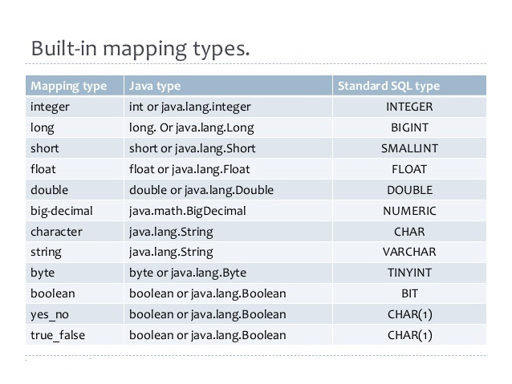
Built In Mapping Types

Slide 19
What Is Configuration File ?
It is an XML file which contains details about database connection.
Hibernate uses this file to establish connection to the database and generate SQL code for that particular database.
Standard name for it is “hibernate.cfg.xml”

Slide 20
Sample Configuration File
<hibernate-configuration>
<session-factory>
<property name= "connection.driver_class" >oracle.driver.OracleDriver</property>
<property name= "connection.url" >jdbc:oracle:thin:@//Sachin-PC:1521/orcl</property>
<property name= "connection.user" >hibernatebatch</property>
<property name= "connection.password" >students</property>
<property name="dialect">org.hibernate.dialect.Oracle9Dialect</property>
<mapping resource="Employee.hbm.xml" />
.
.
</session-factory>
</hibernate-configuration>

Slide 21
Tags Used In Configuration File
The <property> mapping element
The connection.driver_class, connection.url,connection.username and connection.password <property> elements define JDBC connection info
<property name= "connection.driver_class" >oracle.driver.OracleDriver</property>
<property name= "connection.url" >jdbc:oracle:thin:@//Sachin-PC:1521/orcl</property>
<property name= "connection.user" >hibernatebatch</property>
<property name= "connection.password" >students</property>
<property name="dialect">org.hibernate.dialect.Oracle9Dialect</property>

Slide 22
Tags Used In Configuration File
The dialect property specifies the particular SQL variant with which Hibernate will converse.
In most cases, Hibernate is able to properly determine which dialect to use.
This is particularly useful if our application targets multiple databases.

Slide 23
SQL Dialects
RDBMS | Dialect
Oracle (any version) | org.hibernate.dialect.OracleDialect
Oracle9i | org.hibernate.dialect.Oracle9iDialect
Oracle10g | org.hibernate.dialect.Oracle10gDialect
MySQL | org.hibernate.dialect.MySQLDialect
MySQL with InnoDB | org.hibernate.dialect.MySQLInnoDBDialect
MySQL with MyISAM | org.hibernate.dialect.MySQLMyISAMDialect
DB2 | org.hibernate.dialect.DB2Dialect
Microsoft SQL Server | org.hibernate.dialect.SQLServerDialect

Slide 24
Tags Used In Configuration File
The <mapping> mapping element
The <mapping> element adds the name of the mapping file(s) for persistent classes to the configuration.
The resource attribute of the <mapping/> element causes Hibernate to attempt to locate and load that mapping file
<mapping resource="Employee.hbm.xml" />

Slide 25
What Is A Persistent Class ?
The entire concept of Hibernate is to take the values from Java class attributes and persist them to a database table.
Java classes whose objects or instances will be stored in database tables are called persistent classes in Hibernate.
Hibernate works best if these classes follow some simple rules, also known as the Plain Old Java Object (POJO) programming model.

Slide 26
What Is A Persistent Class ?
There are following main rules of persistent classes:
It should have a default constructor.
All attributes that will be persisted should be declared private and have getXXX and setXXX methods defined.
The class should not extend or implement any specialized classes or interface

Slide 27
A Sample Persistent Class
public class Student {
private int roll;
private String name;
private String addr;
public int getRoll() {
return roll;
}
public void setRoll(int roll) {
this.roll = roll;
}
public String getName() {
return name;
}
public void setName(String name) {
this.name = name;
}
public String getAddr() {
return addr;
}
public void setAddr(String addr) {
this.addr = addr;
}}

